Slide 1

A Project Presentation on
Predictive modelling on Medical cost
Presented by :
Presented to:
Shashank Pandey
Mr. Ranjan Sinha
Batch : 2020-4961
Edubridge India Teacher

Slide 2
Overview
Problem Statement
Problem Solution
Dataset
Algorithms
Software/Hardware Requirements
Output
Conclusion

Slide 3
Problem Statement
Analyzing medical cost with other variables.
Prediction of medical cost.

Slide 4
Proposed Solution
We plot graph between medical cost with other variables present in our data for analyzing purpose.
In this project, we use some machine learning algorithms to predict our medical cost.
Here we use one sample charges data and will apply different algorithms on it.

Slide 5
The Dataset
Here we use Medical Cost Personal Dataset.
Age: age of primary beneficiary
Sex: to describe gender whether it male or female
Bmi: Body mass index
Children: Number of children covered by health insurance / Number of dependents
Smoker: Whether that person do smoking or not
Region: the beneficiary's residential area in the US, northeast, southeast, southwest, northwest.
Charges: Individual medical costs billed by health insurance
We will apply different algorithms which are listed below

Slide 6
Algorithms
Logistic Regression
Scatterplot
Bar plot
Boxplot

Slide 7
Software/Hardware Requirements
Operating System : Windows 7/8/10
Front-End : HTML, CSS, BOOTSRAP
Tools : Python, Anaconda
Language : Python
Process : Intel Processor
RAM : 4GB(min)
Keyboard
Mouse

Slide 8
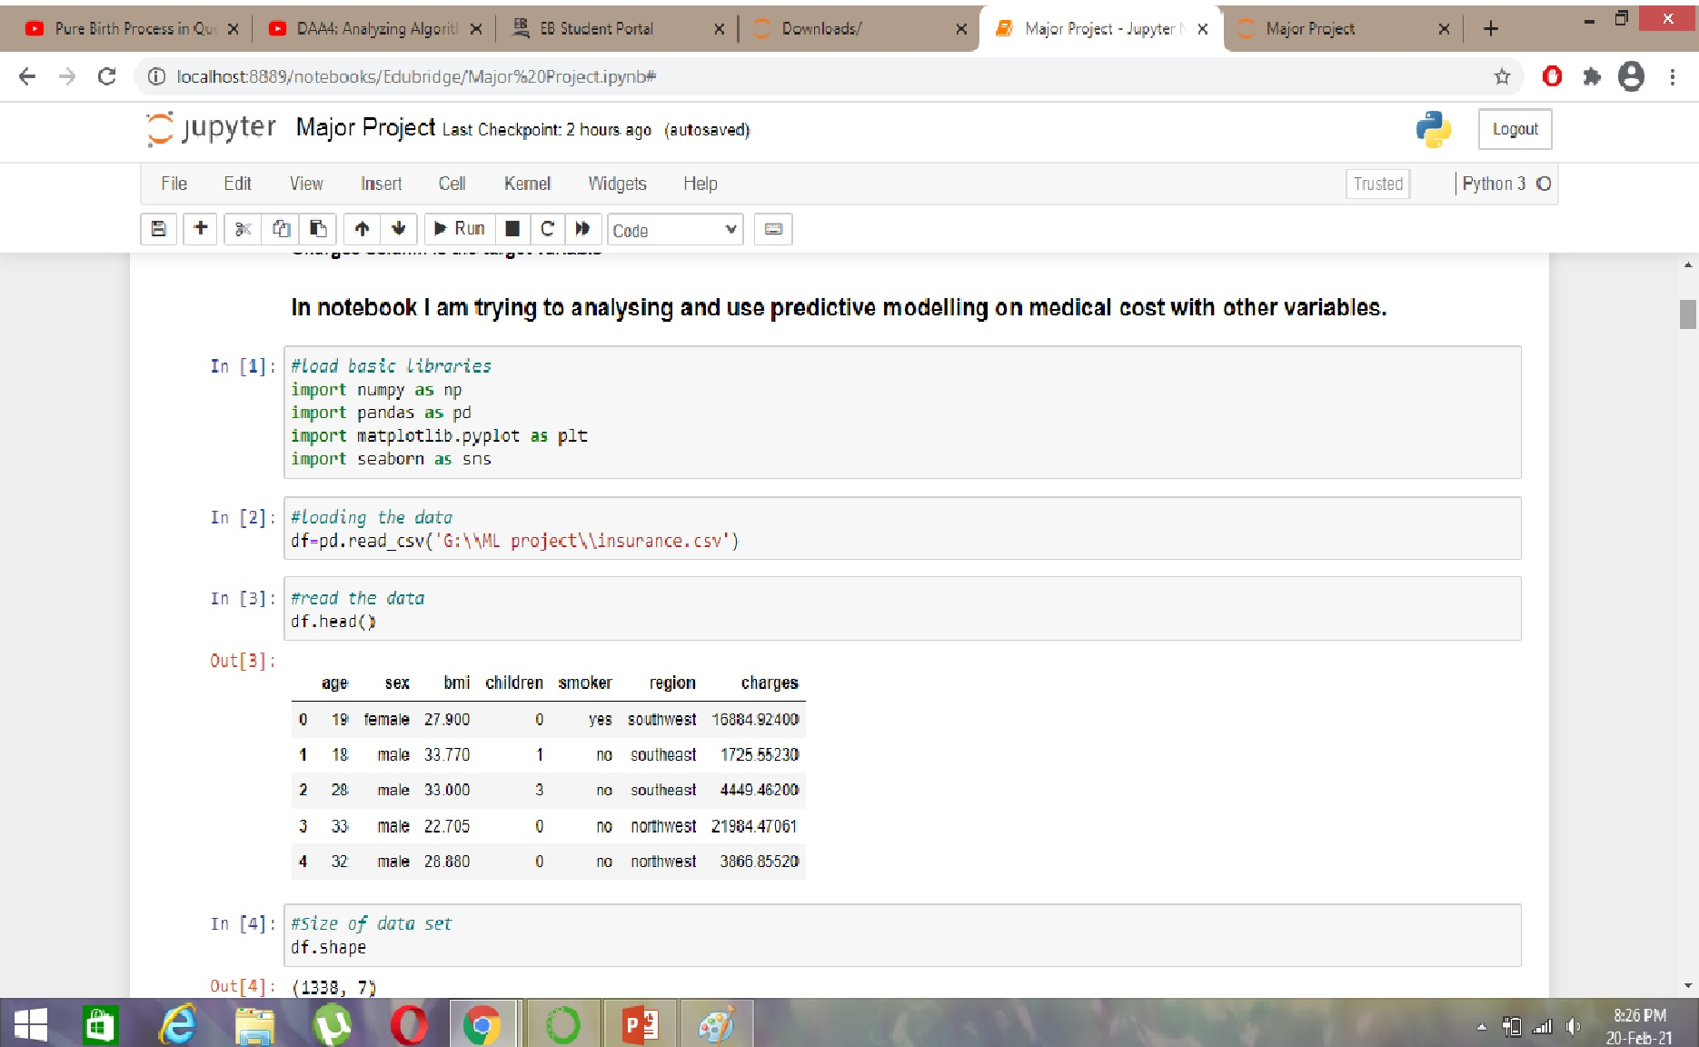

Slide 9
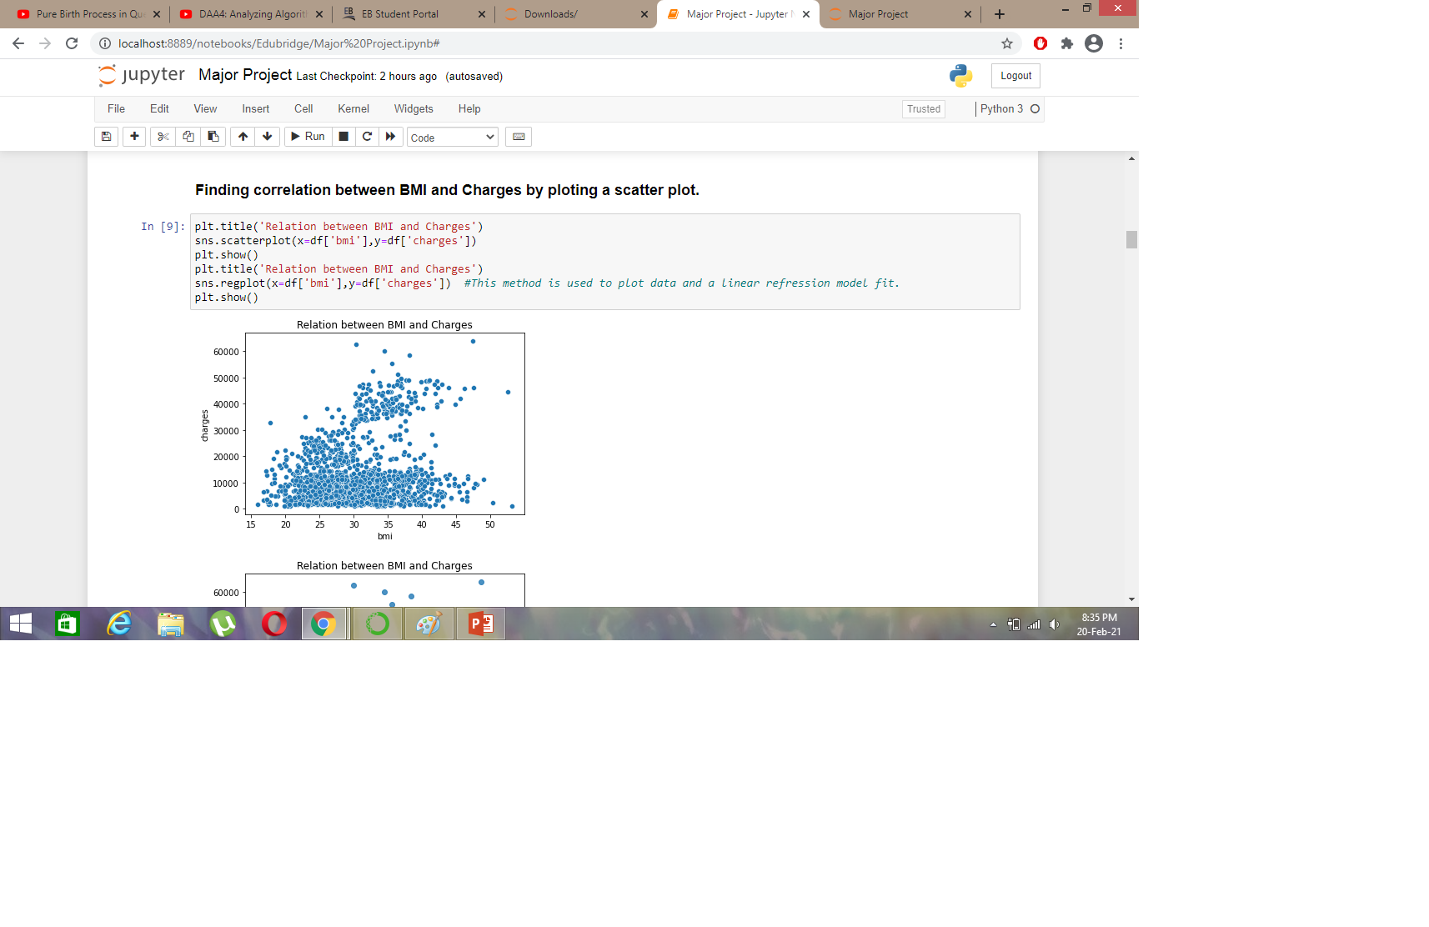

Slide 10
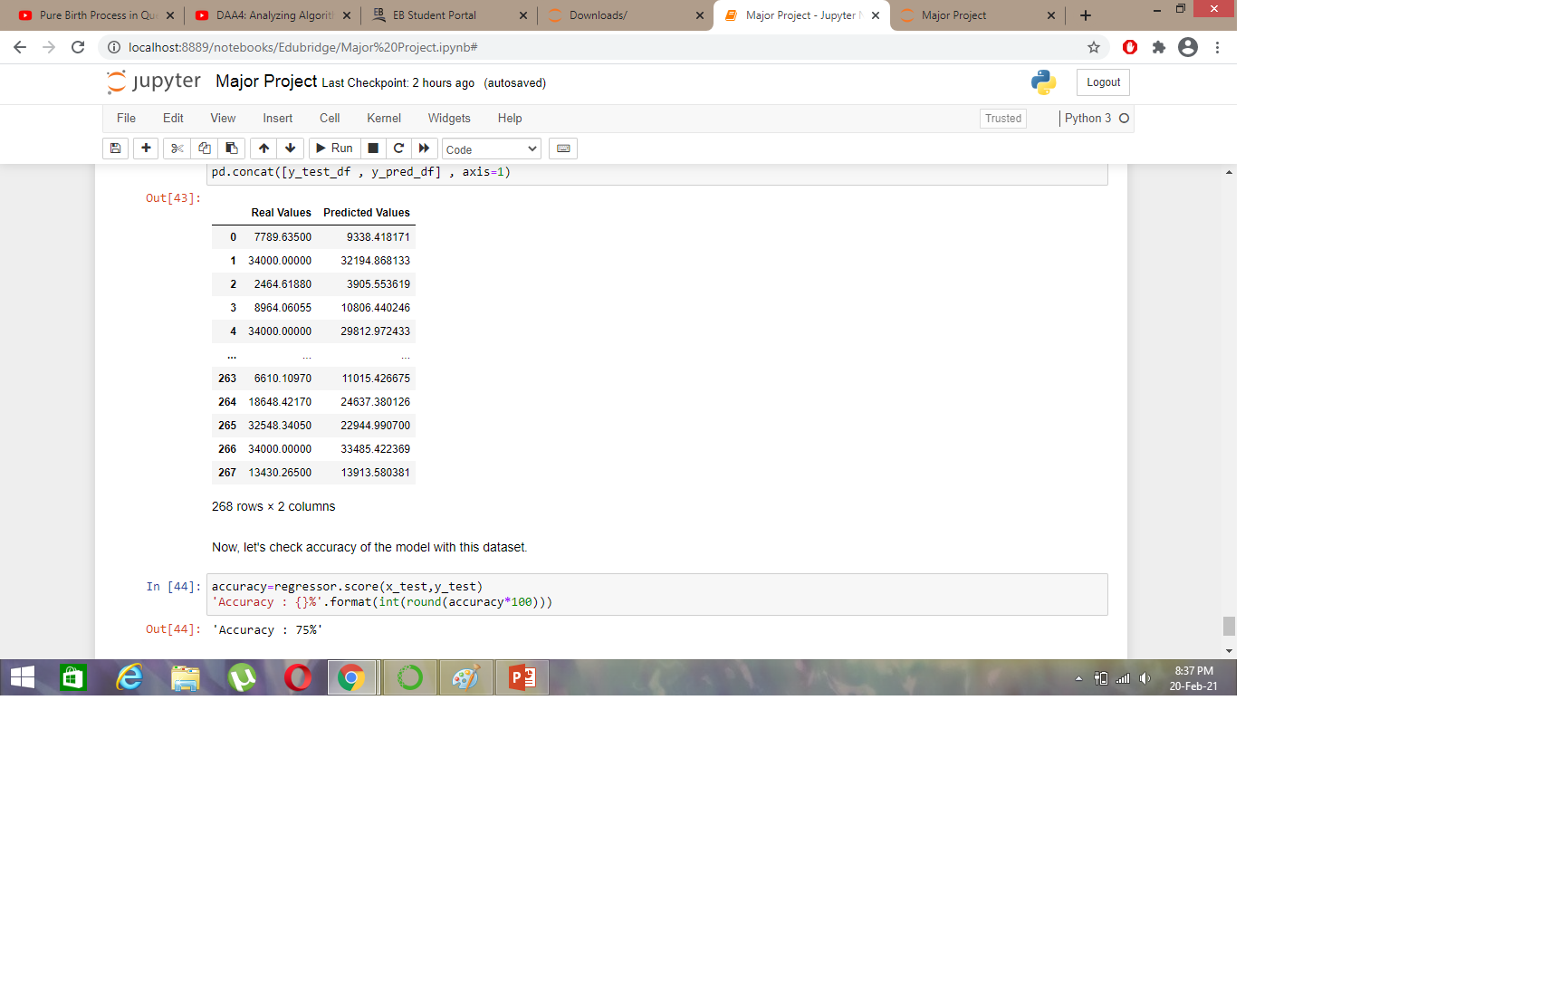
Output

Slide 11
Conclusion
Accuracy of Linear Regression is 75%
Customers with higher BMI typically tend to pay more in insurance costs. The positive regression line proves it.
Person having 2-3 children have to pay more charges but person having 5 children pays the least insurance charges.
We can notice that older people tend to pay slightly more.
Southeast region have to more charges whereas southwest and northwest region having almost equal charges.
Gender of the person does not necessarily determine the insurance charges one pays.

Slide 12
Thank You

